Slide 1
ISSUE NO. 01
THE RETURNS REPORT
Where Returns Are
Draining Revenue —
and What to Do About It
A cancellation-loss investigation into the Online Retail II dataset — two years of transactions, four analytical lenses.
REPORTED BY Sandra Raj Pattuvakkaran (Geography & Time) · Renato Silva (Customer) · Okah Ahone Ebwekoh (Product) · Sudarsh Mekkampurath Sajeev (Support)
DATA SCIENCE AND BUSINESS · DR. EMAN ABUKHOUSA · JULY 2026

Slide 2
00 — THE BUSINESS PROBLEM
Cancellations Are Already Costing Real Money
£1.26M
£1.1M
1,048,576
total cancellation loss, top 10 countries, over two years
of that is the UK alone — 85% of total loss
transaction rows — one cancellation is invisible on its own
With over a million rows of sales alone, this issue is easy to ignore — a single cancellation is just one line among a million. That is exactly how losses like this build up unnoticed, until someone deliberately goes looking.
TO BRING VISIBILITY TO THIS ISSUE
We look at cancellations through four lenses — Geography, Time, Customers, and Products — to find where the money is actually being lost, and what's driving it.
THE RETURNS REPORT · CANCELLATION LOSS ANALYSIS
02 / 14
Notes:
Open with the number: cancellations cost this business roughly £1.26 million over just two years — with the UK alone responsible for £1.1 million of that, 85% of the total. This is money spent on logistics, restocking, and customer service that generated zero revenue. And here's why it's so easy to miss: this dataset alone has over 1 million transaction rows. At that scale, a cancellation is just one row among a million — invisible on its own. Losses like this don't announce themselves; they accumulate silently until you deliberately go looking for them. To bring visibility to this issue, we looked at cancellations through four lenses — geography, time, customers, and products — to find where the money is actually being lost and what's driving it.

Slide 3
00 — METHODOLOGY
One Dataset, Four Lenses
THE DATA
01 Geographic · Comparative rate analysis
Online Retail II (UCI) — UK-based online retailer, Dec 2009–Dec 2011 1,048,576 rows across Invoice, StockCode, Description, Quantity, Date, Price, CustomerID, Country Cancellations directly observable — invoice numbers starting “C”, paired with negative quantity.
Are losses concentrated in specific countries?
02 Temporal · Monthly / quarterly trend analysis
Do losses spike at specific times of year?
03 Customer · RFMR scoring + Spearman correlation
Do certain customers drive most of the loss, and does behavior predict risk?
04 Product · Pareto analysis + price-band segmentation
Do a small number of products account for most of the loss?
THE RETURNS REPORT · CANCELLATION LOSS ANALYSIS
03 / 14
Notes:
We used the Online Retail II dataset from UCI — real transactions from a UK-based online retailer, December 2009 to December 2011, just over 1 million rows across Invoice, StockCode, Description, Quantity, Date, Price, CustomerID, and Country. Cancellations are directly observable — no assumptions needed — flagged by invoice numbers starting with C and negative quantities. Four lenses, each with its own method and question: Geographic uses comparative rate analysis to ask if losses are concentrated in specific countries. Temporal uses monthly and quarterly trend analysis to ask if losses spike at specific times of year. Customer uses RFMR scoring plus Spearman correlation. Product uses Pareto analysis plus price-band segmentation.

Slide 4
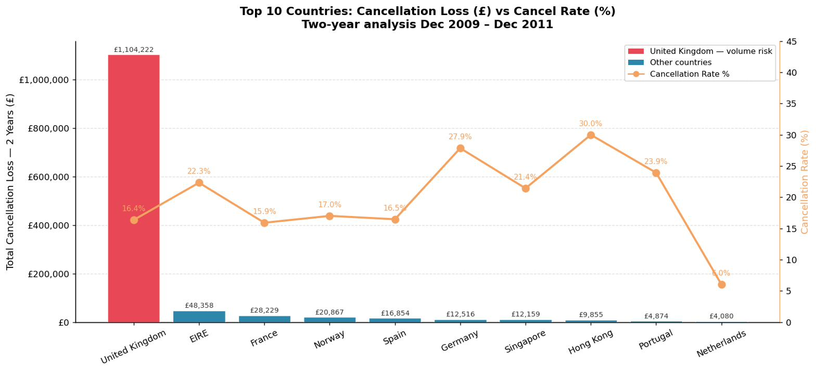
01 — KEY FINDING — GEOGRAPHY
UK Drives Volume — Others Drive Rate
BUSINESS INSIGHT
The UK has the biggest exposure by pounds lost. Germany and EIRE are the bigger problem by rate. Combining the UK, EIRE, France, Norway, Spain, and Germany covers 95% of the total pound losses.
FIG. 01 Top 10 countries — cancellation loss (£) vs. rate (%), two-year window
85.2% of all loss sits in the UK, yet its 16.4% rate is below several smaller markets.
Germany (28.0%) and Hong Kong (28.6%) cancel at nearly double the UK rate — a chi-square test confirms the gap is statistically significant for every country except Sweden.
THE RETURNS REPORT · CANCELLATION LOSS ANALYSIS
04 / 14
Notes:
The UK accounts for 85.2% of total cancellation loss — but its cancellation rate, 16.4%, is actually below several smaller markets. Germany at 28.0% and Hong Kong at 28.6% cancel at nearly double the UK's rate. Six countries — UK, EIRE, Germany, France, Spain, Norway — together make up about 95% of all loss. Why it matters: the UK is your volume and exposure problem. Germany and EIRE are your rate problem.

Slide 5
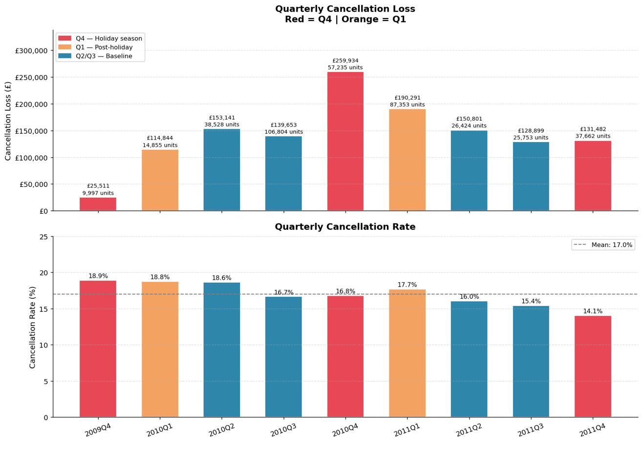
02 — KEY FINDING — TIME
Losses Spike With Volume.
£259,934 lost in Q4 2010 alone — the single largest quarter in the dataset.
The cancellation rate holds steady at ~16.9% across both years — Q4/Q1 spikes come from more orders being placed.
BUSINESS INSIGHT
Pre-position logistics and customer-service resources ahead of Q4 and the Q1 post-holiday wave. The surge is predictable, so staff and stock for it in advance.
FIG. 02 Quarterly cancellation loss (£) and rate (%), Q4 2009 – Q4 2011
THE RETURNS REPORT · CANCELLATION LOSS ANALYSIS
05 / 14
Notes:
Losses spike hard in Q4 2010 at £259,934, and again into Q1 — but the cancellation rate stays flat around 16.9% across both years. Why it matters: this is a capacity problem, not a behavior problem. You can staff and stock for it in advance because it's predictable, not random.

Slide 6
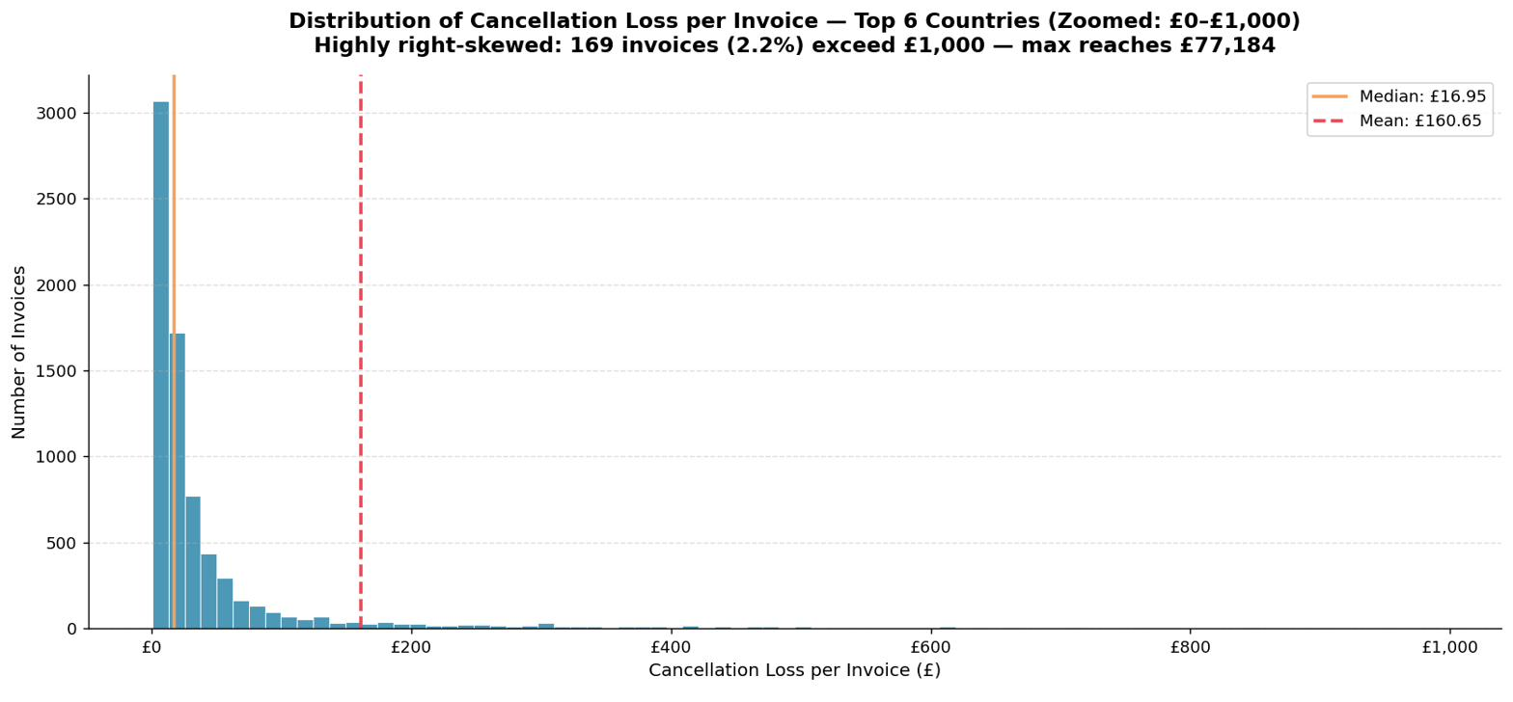
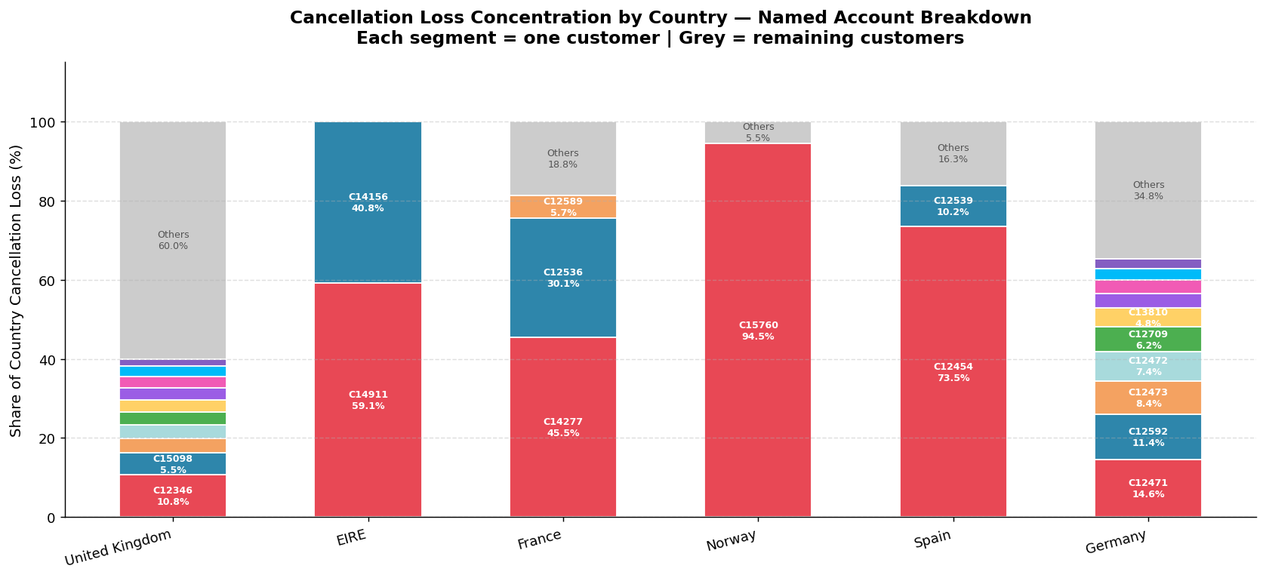
03 — KEY FINDING — CUSTOMER, Q1
Is There a Pareto Pattern? Yes — In Some Countries
FIG. 03 Distribution of loss per invoice, top 6 countries (zoomed £0–£1,000)
FIG. 04 Customers required to reach 80% of cancellation loss, by country
Median £16.95 vs. mean £160.65 — a 9.5x gap. Loss per invoice is heavily right-skewed (max £77,184) — why Pareto, not averages, is the right lens.
PARETO HOLDS
PARETO DOES NOT HOLD
Norway: 1 account = 94.5% EIRE: 2 accounts = ~100% France: 3 accounts = 81.2% Spain: 1 account > 50%
Germany: 19 of 66 accounts needed; top account only 14.6% UK: 190 of 2,292 accounts needed; top account only 10.8%
THE RETURNS REPORT · CANCELLATION LOSS ANALYSIS
06 / 14
Notes:
First, we looked at how cancellation loss is distributed across all invoices in the top six markets. The distribution is heavily right-skewed: median loss per invoice is just £16.95, but the mean is £160.65 — nearly 9.5 times higher. Splitting by country, the answer is yes in some markets, no in others. Pareto holds in Norway, EIRE, France, and Spain. It does not hold in Germany or the UK.

Slide 7
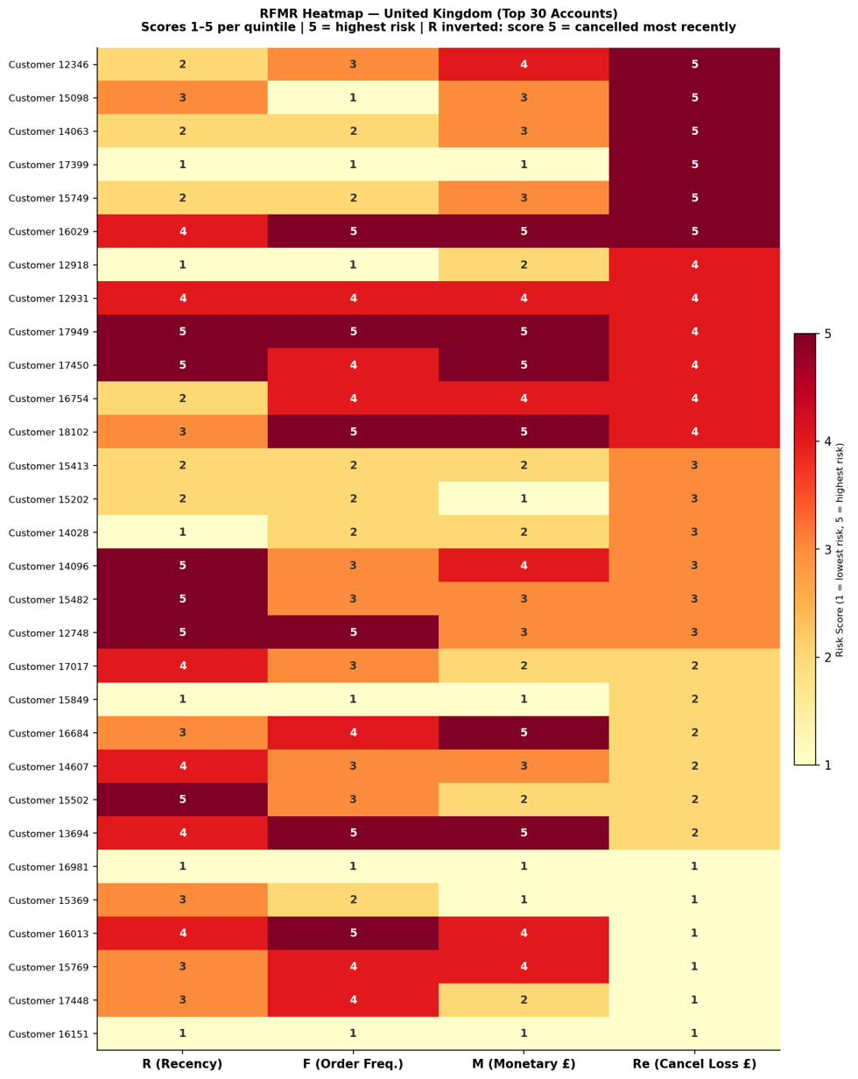
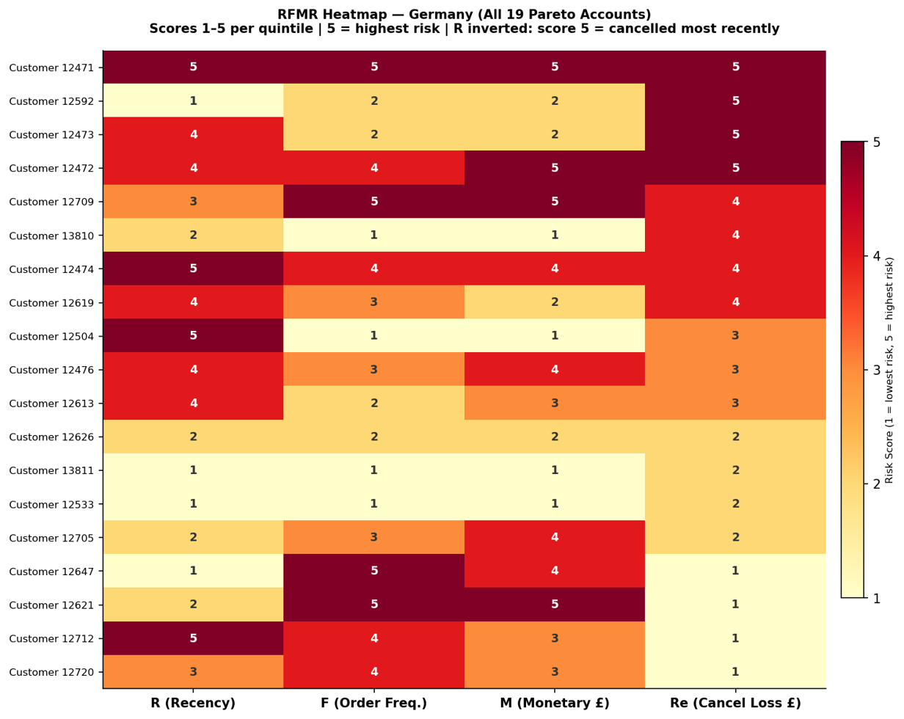
03 — KEY FINDING — CUSTOMER, Q2
What Do the Riskiest Accounts Look Like?
One-Time Disengaged (R 4-5, F 2, M 2) — tried once, canceled, left. High-Value Canceller (R 4-5, F 4-5, M 4-5) — frequent, big-spending, keeps canceling. Next step: K-Means clustering on all 190 UK + 19 German Pareto accounts to validate these segments formally.
UK: ONE PROFILES
One-Time Disengaged (R 1–2, F 1–3, M 3–4 — sizable customers, one big cancellation, then went quiet.
GERMANY: TWO PROFILES
FIG. 06 RFMR heatmap — Germany, all 19 Pareto accounts
FIG. 05 RFMR heatmap — UK, top 30 Pareto accounts
THE RETURNS REPORT · CANCELLATION LOSS ANALYSIS
07 / 14
Notes:
Since Pareto didn't hold for UK and Germany, we dug into their highest-risk accounts using the RFMR framework. In the UK, high-risk accounts share a consistent shape: cancelled a while ago, infrequent buyers, mid-to-large order sizes. In Germany, two distinct profiles emerge: a one-time disengaged buyer, and a high-value chronic canceller. The recommended next step is K-Means clustering to validate whether these groupings hold up statistically.

Slide 8
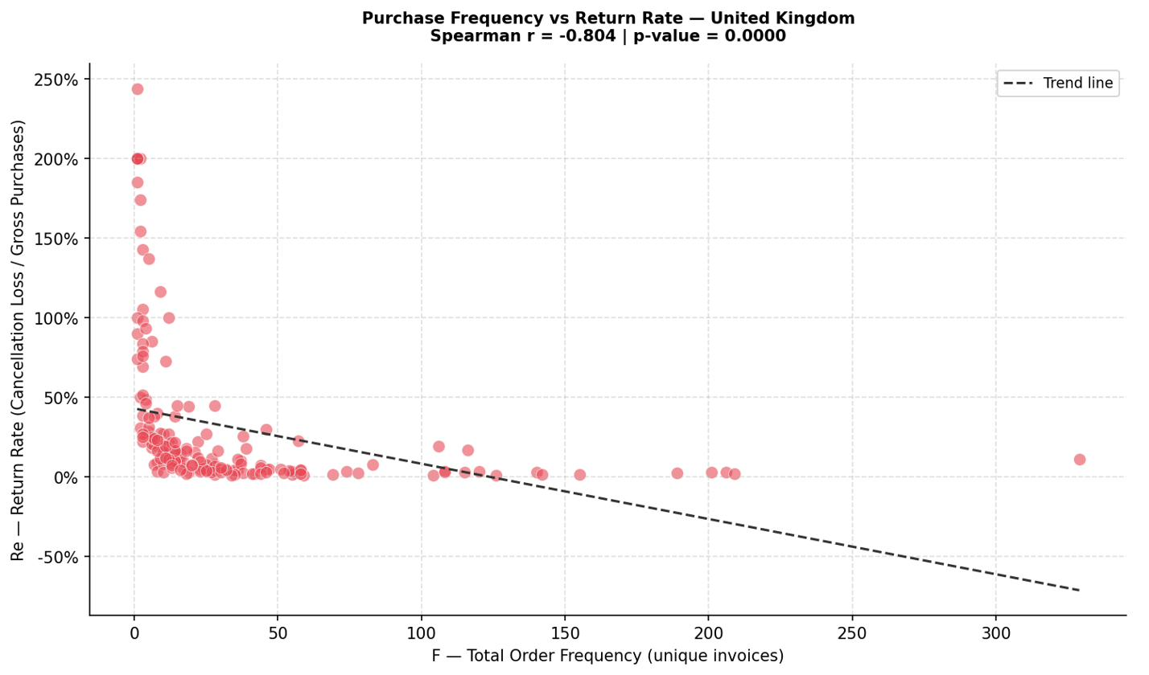
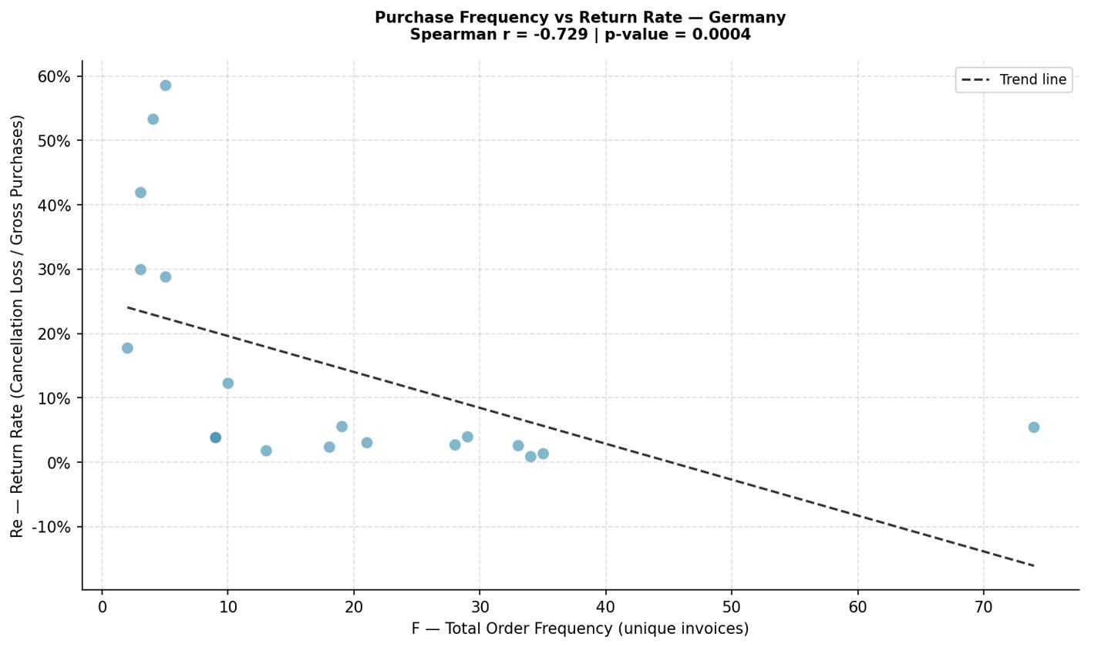
03 — KEY FINDING — CUSTOMER, Q3
Frequent Buyers Cancel Less — and More Predictably
FIG. 07 Purchase frequency vs. return rate — United Kingdom
FIG. 08 Purchase frequency vs. return rate — Germany
r = –0.804 (UK) r = –0.729 (Germany) — both statistically significant (p < 0.001)
Customers who buy most often return least. The scatter shows an L-shape in both markets: low-frequency buyers have wildly variable, often very high return rates; as frequency rises, return rate converges toward zero.
THE RETURNS REPORT · CANCELLATION LOSS ANALYSIS
08 / 14
Notes:
Finally, we found a negative correlation between frequency and return behavior in both the UK and Germany. Spearman r is minus 0.804 in the UK and minus 0.729 in Germany, both statistically significant. Frequency is a usable early-warning signal — low-frequency buyers are the danger zone.

Slide 9
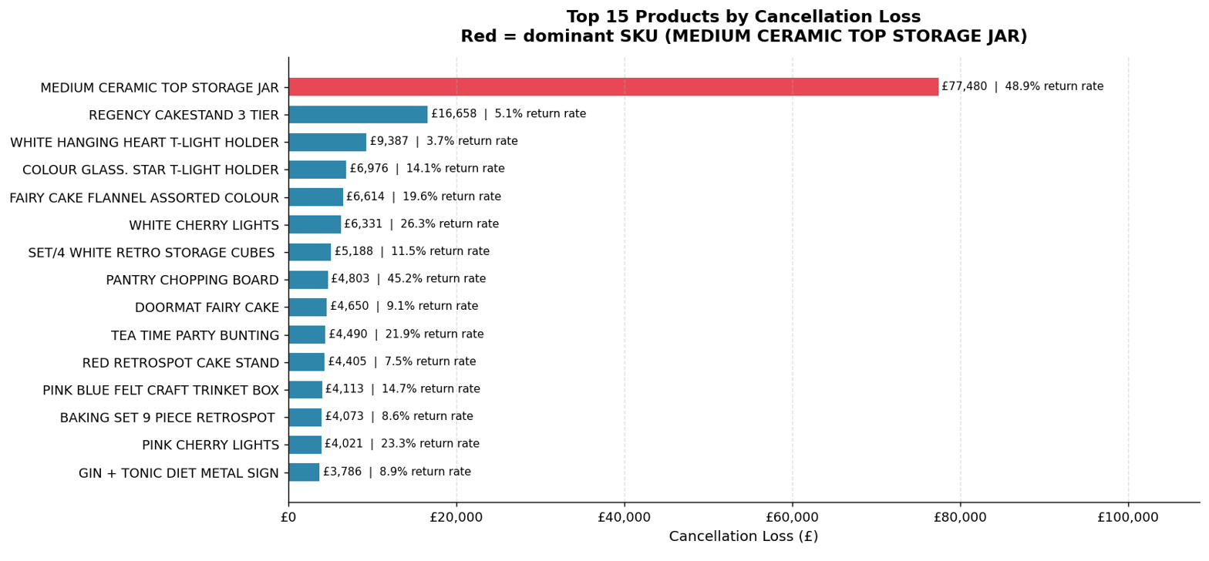
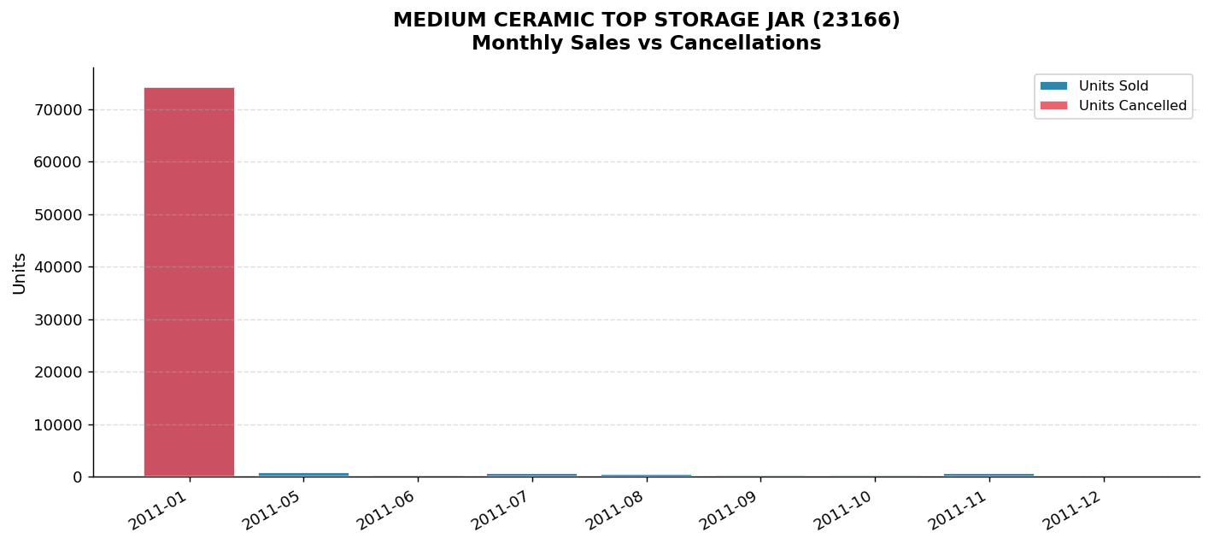
04 — KEY FINDING — PRODUCT, Q1
The Biggest Loss Number Was a One-Time Event
DATA PREP Cancellations flagged as StockCode M (“Manual”) — likely a manual reversal, but we can't tell if it's an accounting adjustment or a real cancellation — were excluded, since they can't be tied to any product. That took us from 1,048,576 rows to 1,039,238 product-level records.
FIG. 10 Medium Ceramic Top Storage Jar — monthly sales vs. cancellations
FIG. 09 Top 15 products by cancellation loss — Ceramic Jar highlighted
BUSINESS INSIGHT
The £77,480 / 48.9% Ceramic Jar figure is one customer's single 74,215-unit cancellation — a one-off, not a quality issue. Several SKUs also run 100% return rates (e.g. Vintage Blue Vacuum Flask) — future repricing/discontinuation candidates.
Ranked by absolute £ loss — the Ceramic Jar (red) tops the list, but ranking by return rate tells a very different story (e.g. Vintage Blue Vacuum Flask at 100%).
THE RETURNS REPORT · CANCELLATION LOSS ANALYSIS
09 / 14
Notes:
A large share of cancellations were flagged as StockCode M, or Manual. Since it can't be tied to any product, we excluded it, taking us from 1,048,576 rows to 1,039,238 product-level records. The Medium Ceramic Top Storage Jar is the highest-loss product — £77,480, 48.9% return rate — but nearly the entire loss comes from one customer cancelling 74,215 units in a single transaction. Several SKUs carry a 100% return rate — worth flagging as candidates for discontinuation or repricing.

Slide 10
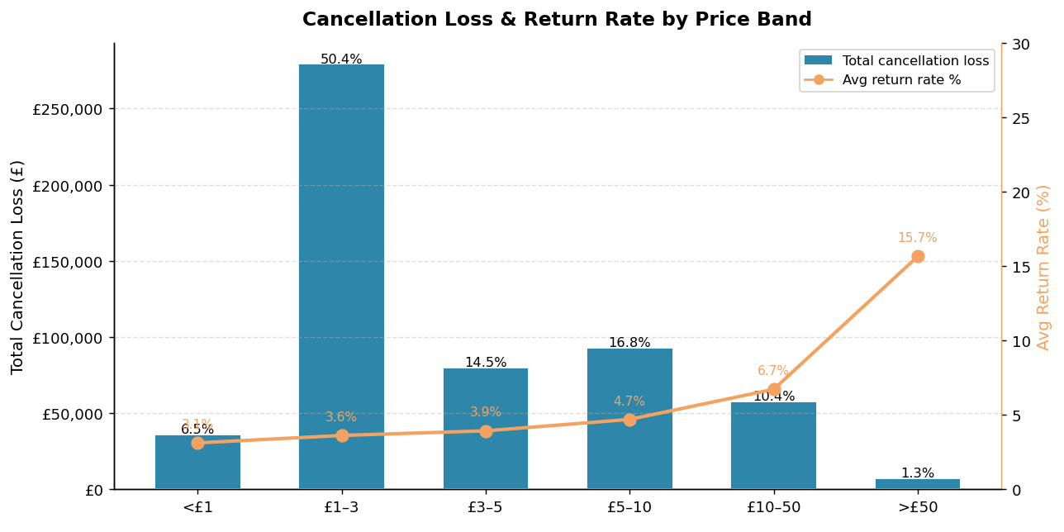
04 — KEY FINDING — PRODUCT, Q2
Cheap Items Lose by Volume, Expensive Items Lose by Rate
WHAT THE BANDS SHOW
£1–3 band = 50.4% of loss (£279,211) — simply because most of the catalog is priced there. Return rate climbs with price: 3.1% (<£1) → 15.7% (>£50) — a 5x jump. So what: Expensive items need a quality or fulfillment review.
FIG. 11 Cancellation loss (£) and return rate (%) by price band
THE RETURNS REPORT · CANCELLATION LOSS ANALYSIS
10 / 14
Notes:
Most cancelled products fall into the £1 to £3 price band, simply because most of the catalog is priced there. Return rate tells a different story: it rises from 3.1% for items under £1 up to 15.7% for items over £50 — roughly five times higher. Cheap items lose money through volume; expensive items lose money through rate.

Slide 11
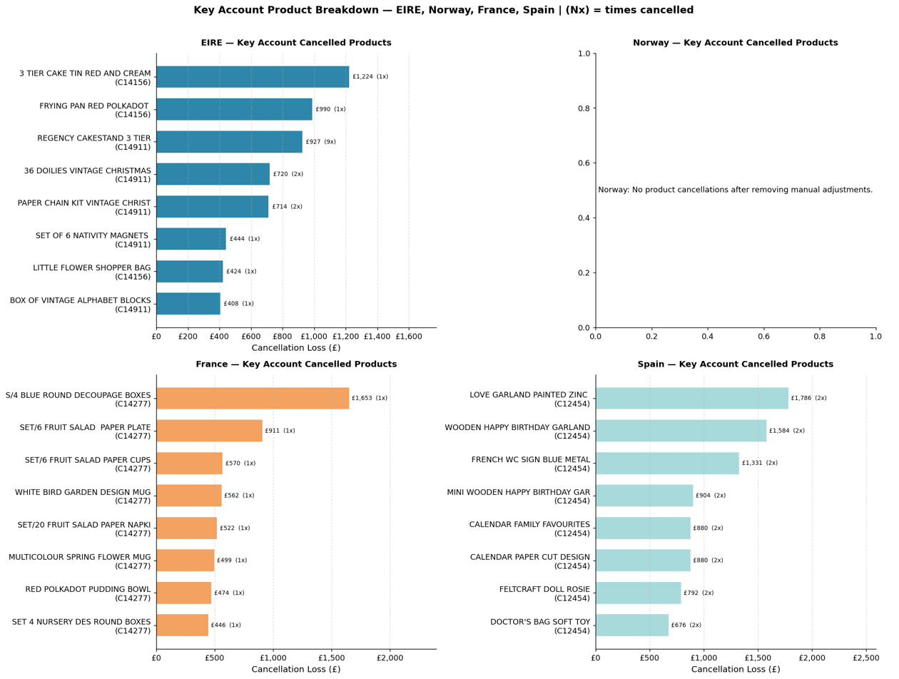
04 — KEY FINDING — PRODUCT, Q3
A Broader Pareto Pattern — With Two Real Signals
438 of 3,058 SKUs (14.3%) account for 80% of product cancellation loss — the same Pareto pattern as geography (1 country = 85%), but far broader, so category/price-band management beats SKU-by-SKU management.
Norway
No signal — once StockCode M is stripped out, activity is gone.
France
No signal — traces to one wholesale transaction (Customer 14277, Sep 2010).
EIRE
Genuine signal — Regency homeware/tea line keeps recurring over time.
Spain
Genuine signal — Customer 12454 repeatedly cancels the same home-décor SKUs.
FIG. 12 Key account product breakdown — EIRE, Norway, France, Spain
THE RETURNS REPORT · CANCELLATION LOSS ANALYSIS
11 / 14
Notes:
Of the 3,058 SKUs cancelled, 438, or 14.3%, account for 80% of cancellation dollar value — a broader pattern than geography, meaning category or price-band management beats SKU-by-SKU management. Norway and France show no underlying product signal once account-level noise is removed. EIRE and Spain both show genuine, recurring product signals.

Slide 12
05 — BUSINESS RECOMMENDATIONS
Three Responses, Not One Policy
SCOPE Focus on the top six countries — 95% of total loss. The UK is both the priority (85% of £ exposure) and the most complex market (190 accounts, no dominant one).
01 Control
02 Investigate
03 Retain
Add friction to one-off order risk
Look for a product / experience problem
Engage directly — this account is worth keeping
EIRE / Norway / France / Spain Pareto accounts: order-confirmation or deposit requirements for large B2B orders
Germany Profile 1 (one-time disengaged): review product descriptions / category fit for first-time German buyers
Germany Profile 2 (high-value chronic cancellers): frequent, high-spending, keeps cancelling — direct outreach to convert into a stable, high-value account rather than losing them to restrictive controls
UK top accounts: minimum order thresholds + staged payment terms for large one-off orders — protects future exposure without touching loyal buyers
EIRE Regency line: months of recurring cancellation across a coherent product family — review quality & fulfillment
Spain home décor: Customer 12454's repeat cancellations — investigate before scaling the line
THE THROUGHLINE Don't treat every cancellation the same way. Applying the wrong response — friction, investigation, or retention — to the wrong group either wastes effort or drives away revenue you want to keep.
THE RETURNS REPORT · CANCELLATION LOSS ANALYSIS
12 / 14

Slide 13
06 — LIMITATIONS & FUTURE WORK
Honest Constraints, Clear Next Steps
LIMITATIONS
FUTURE WORK
Geographic Country-level only — no city/postal data to test location or distribution-distance effects
K-Means clustering on the four RFMR dimensions across all 190 UK and 19 German Pareto accounts, to formally validate the behavioral segments
Account-by-account review for EIRE, Norway, France, Spain — low account counts make manual review the most effective path
Temporal Only 2 full calendar years / 2 Q4 cycles observed — seasonality is inferred, not statistically confirmed
City/postal-level data to test logistics-distance and regional effects, especially in the UK
Customer RFMR scores are per-country quintiles — not comparable across countries in absolute terms
Longer time series (4–5 years) to confirm seasonality statistically
Category and supplier enrichment to test whether category or supplier drives cancellation risk
Product StockCode M is ambiguous (accounting vs. real cancellation).
Return-reason codes — the biggest gap. Every section shows what is happening but not why.
THE RETURNS REPORT · CANCELLATION LOSS ANALYSIS
13 / 14
Notes:
Geographic: data is recorded at country level only. Temporal: seasonality is a strong but inferred pattern, not statistically confirmed. Customer: RFMR scores are per-country and not comparable across markets. Product: StockCode M introduces real ambiguity. Future work: K-Means clustering, manual account review for small markets, postal data, a longer time series, category and supplier enrichment, and return-reason codes.

Slide 14
Thank You
Questions & Discussion
Sandra · Renato · Okah · Sudarsh
END OF ISSUE NO. 01

